Slide 1
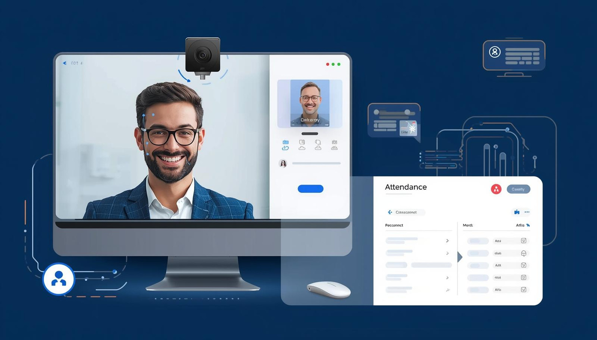
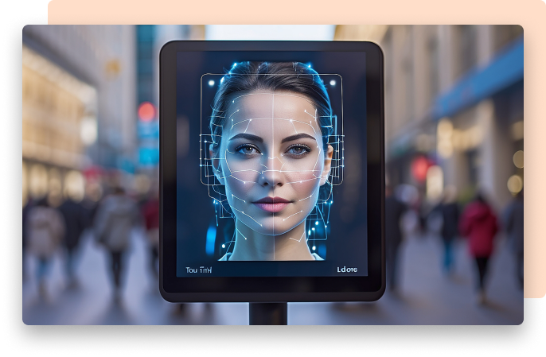
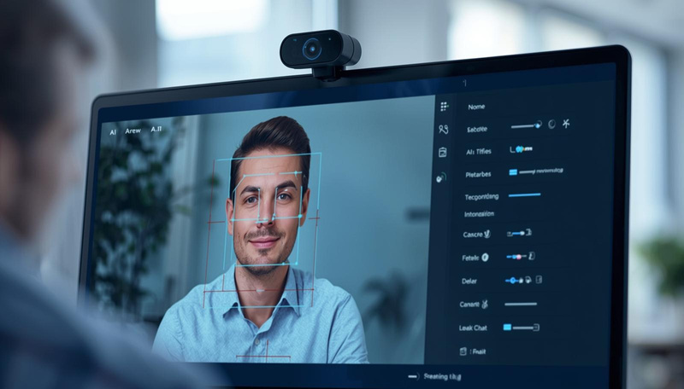
AI-Powered Webcam Attendance System
Submitted to :
Dr Rizwan Alam
Made By: Aashi Arora

Slide 2
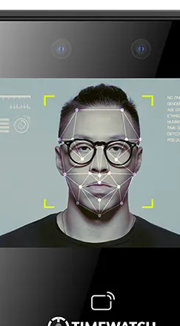
The Challenge: Seamless Real-Time Attendance
Developing a robust attendance system that operates solely via a laptop webcam, addressing critical needs in real-time:
Accurate person detection and identity recognition.
Effective handling of occlusions.
Precise entry/exit movement tracking.
Reliable confidence scoring and automatic logging.

Slide 3





Core System Objectives
Achieve detection of multiple individuals at a rate exceeding 10 frames per second (FPS).
Accurately recognise individuals from a concise, pre-established dataset.
Maintain recognition accuracy despite masks, glasses, hoodies, helmets, and other obstructions.
Precisely identify when individuals are entering or exiting the monitored area.
Log attendance with accurate timestamps and corresponding confidence scores for each event.
Multi-Person Detection
Identity Recognition
Occlusion Robustness
Entry/Exit Identification
Automated Logging

Slide 4






Underpinning Technologies
DeepFace (Facenet)
OpenCV
YOLO
Python & Offline AI
Speech Recognition
Pandas
Identify market needs and initial concepts for a new product.
Develop the main design and features of the product before prototyping.
Analyze trends and customer needs to validate the product idea.
Test the initial product to identify issues and improvements.
Iterate based on feedback from product testing results.
The product is launched to the market with an integrated marketing strategy.

Slide 5



Dataset Preparation & Encoding
Image Acquisition
Each individual's profile involves capturing approximately 20 unique images using a dedicated collect_data.py script.
Structured Storage
Images are meticulously organised and stored within individual subdirectories, specifically dataset/<name>/, for streamlined management.
Embedding Generation
Facial features from these images are then converted into numerical 'embeddings' via the face_encoder.py script, creating a unique digital signature for each person.

Slide 6



Precise Face Recognition Logic
REAL-TIME EMBEDDING COMPARISON
CONFIDENCE SCORING
PERSISTENT RE-IDENTIFICATION
Live facial embeddings captured from the webcam feed are continuously compared against the pre-stored database of known embeddings.
A sophisticated distance-to-confidence formula is applied to quantify the certainty of an identity match, ensuring high accuracy.
The system is designed to seamlessly re-identify individuals upon their return, maintaining consistent tracking throughout the session.

Slide 7
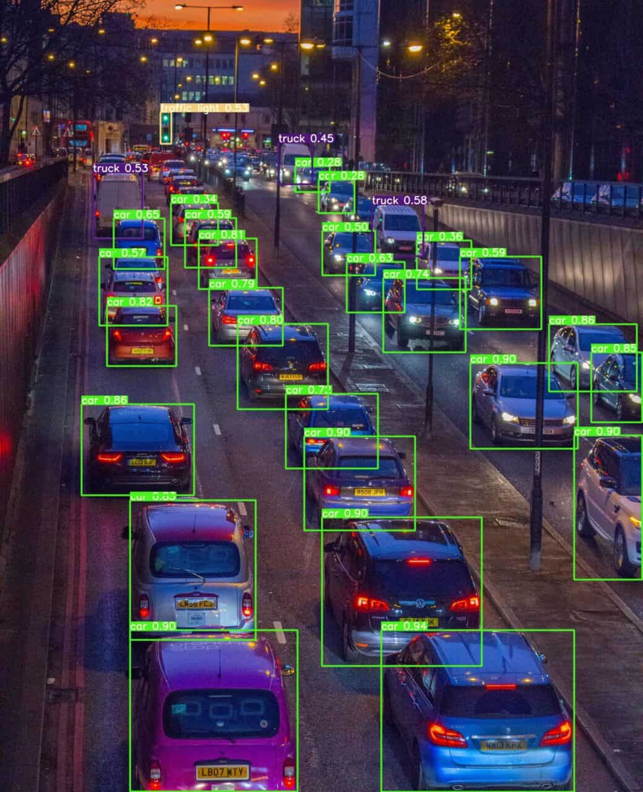
Robust Multi-Person Detection with YOLO
The You Only Look Once (YOLO) model is integral to our system, providing efficient and accurate detection of multiple individuals.
Human Detection: YOLO processes the webcam feed to identify all human subjects present within the frame.
Bounding Boxes: For each detected person, a precise bounding box is drawn, delineating their presence and position in real-time.
Foundation for Tracking: This visual identification serves as the critical first step for subsequent identity recognition and movement tracking.

Slide 8



Robust Multi-Person Detection with YOLO
The You Only Look Once (YOLO) model is integral to our system, providing efficient and accurate detection of multiple individuals.
Human Detection
Bounding Boxes
Foundation for Tracking
YOLO processes the webcam feed to identify all human subjects present within the frame.
For each detected person, a precise bounding box is drawn, delineating their presence and position in real-time.
This visual identification serves as the critical first step for subsequent identity recognition and movement tracking.

Slide 9
Robust Multi-Person Detection with YOLO
The You Only Look Once (YOLO) model is integral to our system, providing efficient and accurate detection of multiple individuals.
Human Detection: YOLO processes the webcam feed to identify all human subjects present within the frame.
Bounding Boxes: For each detected person, a precise bounding box is drawn, delineating their presence and position in real-time.
Foundation for Tracking: This visual identification serves as the critical first step for subsequent identity recognition and movement tracking.

Slide 10





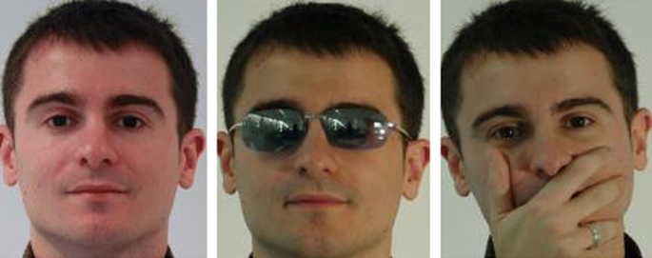
Advanced Occlusion Handling
Skin Tone Diversity: Ensures equitable performance across a wide spectrum of skin tones.
Glasses & Headwear: Adapts to individuals wearing prescription glasses, sunglasses, hoodies, or helmets.
Our system maintains high recognition accuracy even when faces are partially obscured, demonstrating resilience across various challenging scenarios:
Lighting Conditions: Performs reliably under varying light levels, including low-light environments.
Masks: Recognises individuals wearing face masks.

Slide 11




Precise Movement Detection: Entry & Exit
To accurately log attendance, the system meticulously tracks individual movement:
Zone Segmentation
Centroid Tracking
The monitored screen area is conceptually divided into distinct 'Entry' and 'Exit' zones to define movement boundaries.
The centroid of each detected person's bounding box is tracked across consecutive frames to map their trajectory.
Entry Confirmation
Exit Timestamp Update
Attendance is officially marked only upon confirmed traversal into the 'Entry' zone, ensuring deliberate presence.
The exit timestamp for an individual is automatically recorded and updated upon confirmed movement into the 'Exit' zone.

Slide 12



Comprehensive Attendance Logging
All attendance data is meticulously recorded in a structured CSV file, providing a clear and accessible record.
Data Fields
Duplicate Prevention
Each entry includes essential information: Name, Entry Time, Exit Time, and Confidence Score.
The system incorporates logic to prevent duplicate entries, ensuring the integrity and accuracy of the attendance log.
Numeric Timestamps
All timestamps are stored in a clear numeric format, avoiding any complex or hashed representations.

Slide 13
Challenges Faced
Heavy real-time lag due to face detection + encoding + tracking + CSV operations in one loop
My face recognized with low precision, earlier showed Unknown & 0 confidence
Entry/Exit movement misclassified, both labeled as exit
CSV stored in hash format, corrupted headers & repeated overwrites
Bounding box flickering when occlusion, lighting or partial faces
Voice command failures due to missing/incorrect dependencies (e.g., PyAudio)
Voice commands didn’t trigger actions reliably due to async listening + movement mismatch
Multiple duplicate entries logged for same person
Limited offline performance tuning for FPS and tracking stability

Slide 14
Conclusion
The AI-Powered Laptop-Camera Attendance System was successfully developed using MTCNN for multi-person face detection and FaceNet embeddings for identity recognition, enabling real-time re-identification even under occlusions such as masks, glasses, hoodies, and helmets. The system supports automatic attendance marking when no voice command is given for 7 seconds, while also allowing manual marking through speech input using commands like “mark attendance for (name)”. Attendance logs now record human-readable entry and exit timestamps along with classification labels, ensuring the CSV file stores correct numerical date-time values without hashing or corruption. Live overlays display a persistent list of users marked IN and those who have exited, improving visibility on screen, while movement direction tracking and bounding box stability were enhanced to reduce flicker and lag. Bonus AI features, including Reinforcement Learning-based smart zoom simulation, LLM-powered attendance queries, voice command control, and attendance analytics, were also integrated, making the solution functional, intelligent, and fully aligned with hackathon expectations and deliverables.

Slide 15


Thank you

Slide 16
Thank you

